Slide 1
Image Classification
Using Glimpses
James Landry & Abdulmateen Adebiyi

Slide 2
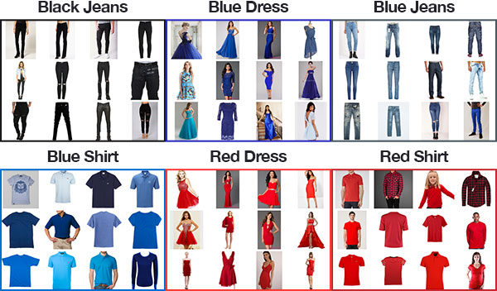
Image Classification
Pattern recognition for images and correctly predicting what an image is based on previous images.

Slide 3

Glimpses
Instead of focusing on the whole image, the network focuses on a small portion at a time.

Slide 4
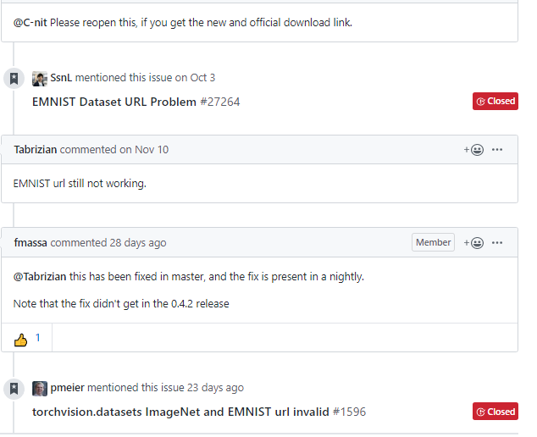
THE LINK (inside Pytorch’s datasets) WAS BROKEN!
Our Project
Initially, we set out to use the EMNIST dataset, which was a large dataset of handwritten characters, but...

Slide 5
Solution
Since the link to the dataset was broken, we had to transition to a different one. We decided on the FashionMNIST dataset.

Slide 6
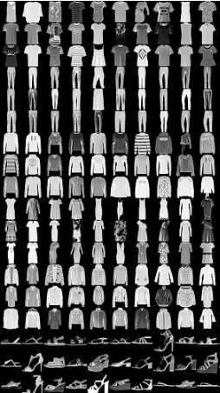
Our Network
Our network is a Recurrent Neural Network that uses the glimpses during the training process to (relatively) quickly try and train the network.

Slide 7

Our Network
Our network, on start of training, splits the set into train and validation sets. In our code, there is a separate file to be able to manipulate the hyperparameters, such as learning rate, number of epochs to run, how many glimpses should be made, etc.

Slide 8

Our Results
Using a learning rate of 0.0003, 6 glimpses per image, and 50 epochs, our best training accuracy was 80.050% (Epoch 47), and bets validation accuracy was 85.650% (Epoch 46).

Slide 9
Conclusion
The previous accuracies are relatively low for that dataset, but turning the hyperparameters are difficult. The training where those numbers came from took well over 1.5 hours to complete (2.2GHz processor, dual core).
Further tweaks many be able find a suitable set of hyperparameters.

Slide 10
Questions?

